Slide 1
Image Encryption
By:
Krzysztof Pawlik x16138147
David Harrop x03298051

Slide 2
What is image encryption ?
“Visual cryptography is a cryptographic technique which allows visual information to be encrypted in such a way that decryption becomes the job of the person to decrypt via sight reading.”
https://en.wikipedia.org/wiki/Visual_cryptography
Notes:
Why protect images by encryption ?
To provide Confidentiality of storing-sending images
To make sure that Integrity is easy to verify
To provide Authentication of images

Slide 3
Objectives:
Project problem:
Develop an application that encrypts the image.
Problem solution:
-Java application that take image file as an input
-Ask user for security password that meet specific requirement
-Encrypt it and store hashed (SHA-512) password in the file

Slide 4
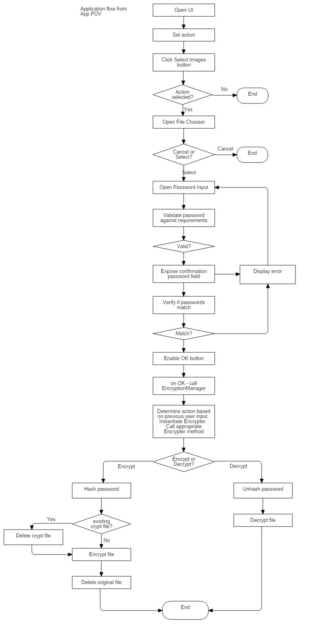
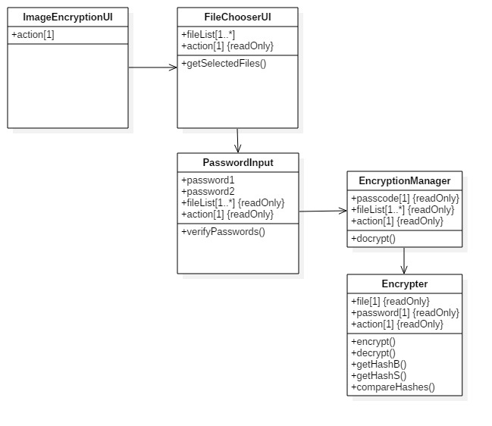
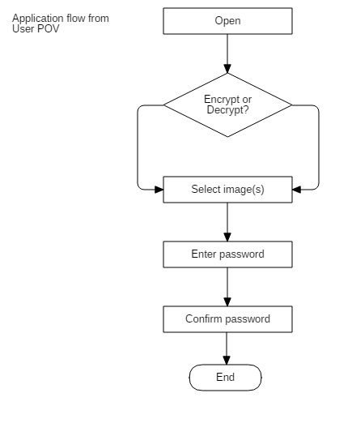

Slide 5

Code snippet –password verification

Slide 6

Code snippet –encryption method

Slide 7
Conclusion:
Prototype shows simple way how to encrypt images and secure this encryption by password.
Password meet security requirement.
Application can be used as a base for more complex solutions such as folder and multiple files encryption.

Slide 8

This Photo by Unknown Author is licensed under CC BY-SA

